Slide 1
Casual & Member Bike Usage
An analysis of Cyclistic bike data, distinguishing characteristics between casual and member bikers.
Andrew Selvig
Last Updated: November 29, 2023
Notes:
Hello, my name is Andrew Selvig, and coming up is an analysis of Cyclistic bike data, distinguishing characteristics between casual and member bikers.

Slide 2
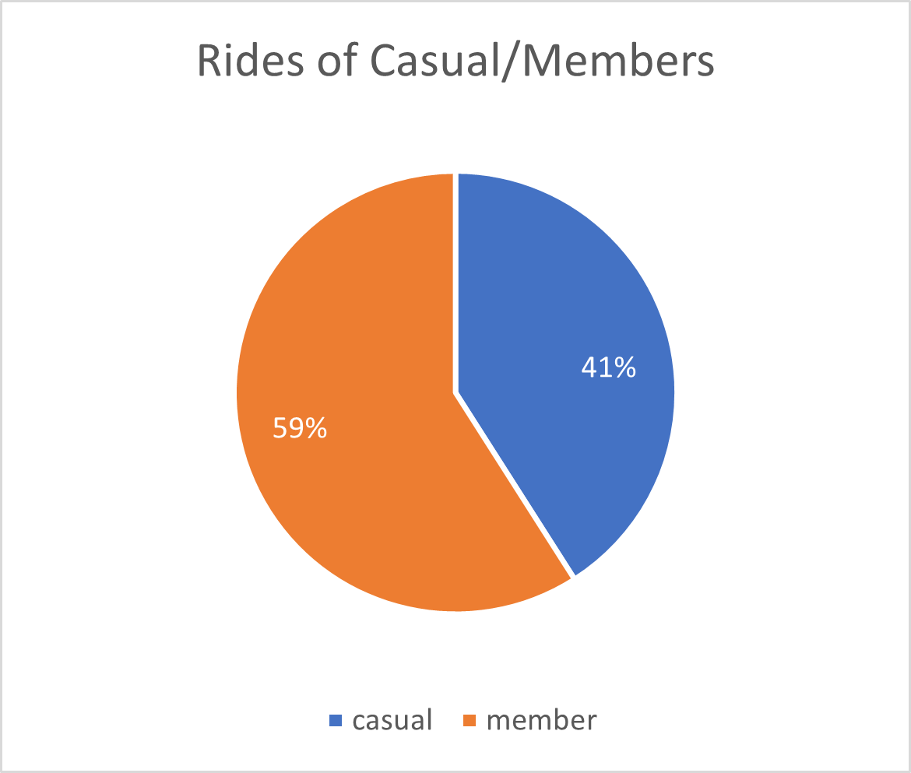
Purpose
Current high portion of casual riders
Higher revenue in members
Different Groups
Notes:
To start, currently at Cyclistic, there is a high portion of users who are just casual riders. Although a high amount of our riders are members (59%), that portion can be improved upon. We can convert more of our casual riders into loyal customers in our member program.
With higher membership, we will receive more revenue, allowing us to expand our company to assist more people.
To solve the problem, it must be understood what separates the current casual and member riders.

Slide 3
Agenda
Ride Length by Users
Average Ride Length
Conclusions
Taking Actions
Notes:
In this presentation, the average ride length of users will be analyzed. This will help suggest tendencies for both of our groups.
Likewise, the average ride length of each groups will be analyzed, further supporting suspicions.

Slide 4
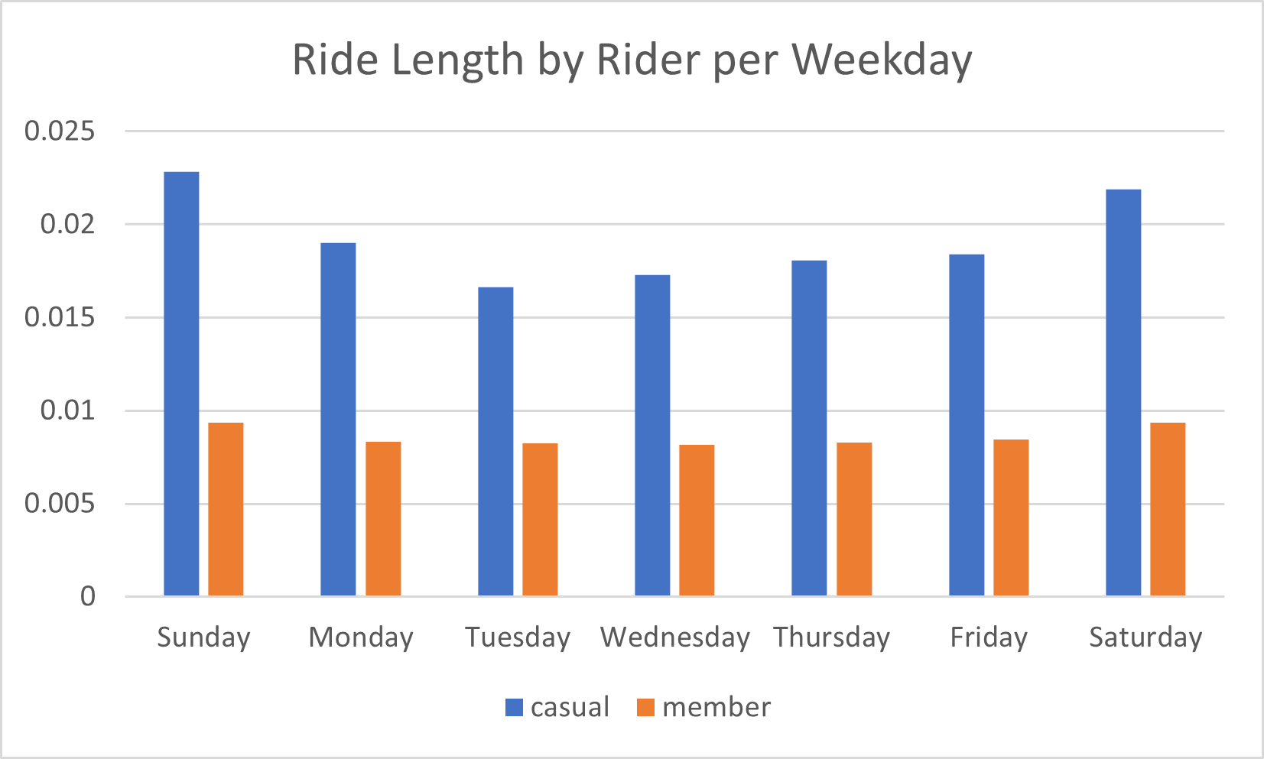
Ride Length by Riders
Longer rides for casual members
Longer casual rides on weekends
Notes:
In this graph, the average ride length of users is displayed. It is broken down per weekday.
As shown, casual members tend to gravitate more towards having longer rides on the weekends, rather than the weekdays. This suggests that casual users may like to use bikes recreationally, rather than for practical purposes, such as going to work or the grocery store, as our member riders may do.

Slide 5
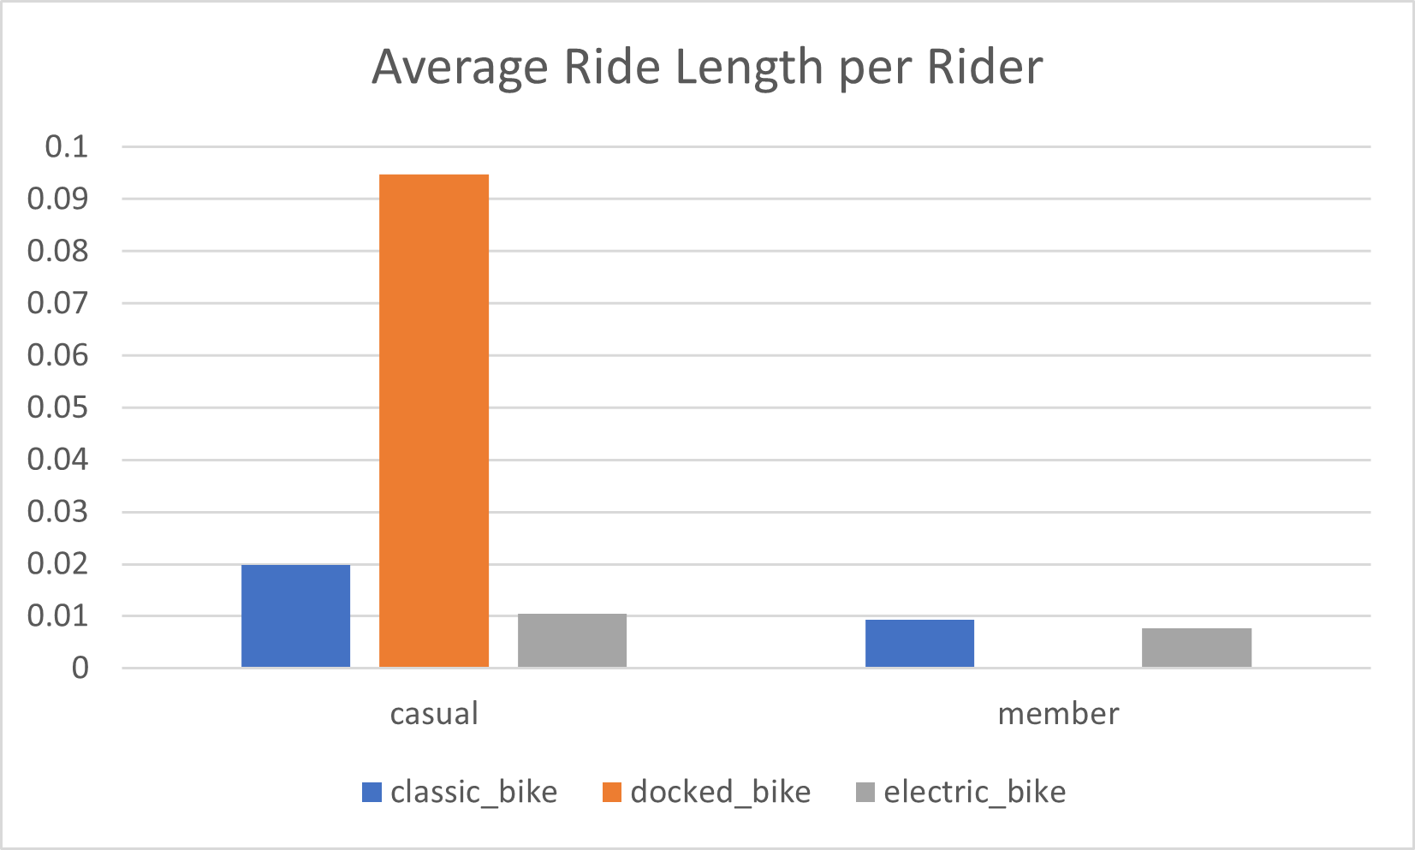
Average Ride Length
Docked bikes in bike usage
Length of Bike Rides
Shorter Member Rides
Notes:
Moving on, this graph illustrates the average ride length again, but divided between which kind of bike our casual and member bikers use.
To address the immediate outlier, for casual riders, an unusual amount of time is spent on bikes being docked. Although this may seem pointless and certainly accidental, an opportunity can be made with this information.
As may be expected, classic bike rides are longer than their electric bike counterparts, regardless of the type of biker riding them.
Between the casual and member bikers, members tend to have shorter ride length times. This would further suggest that members tend to use bikes for regular use, and casual bikers tend to use bikes more for recreation where there may not be a set destination in mind.

Slide 6
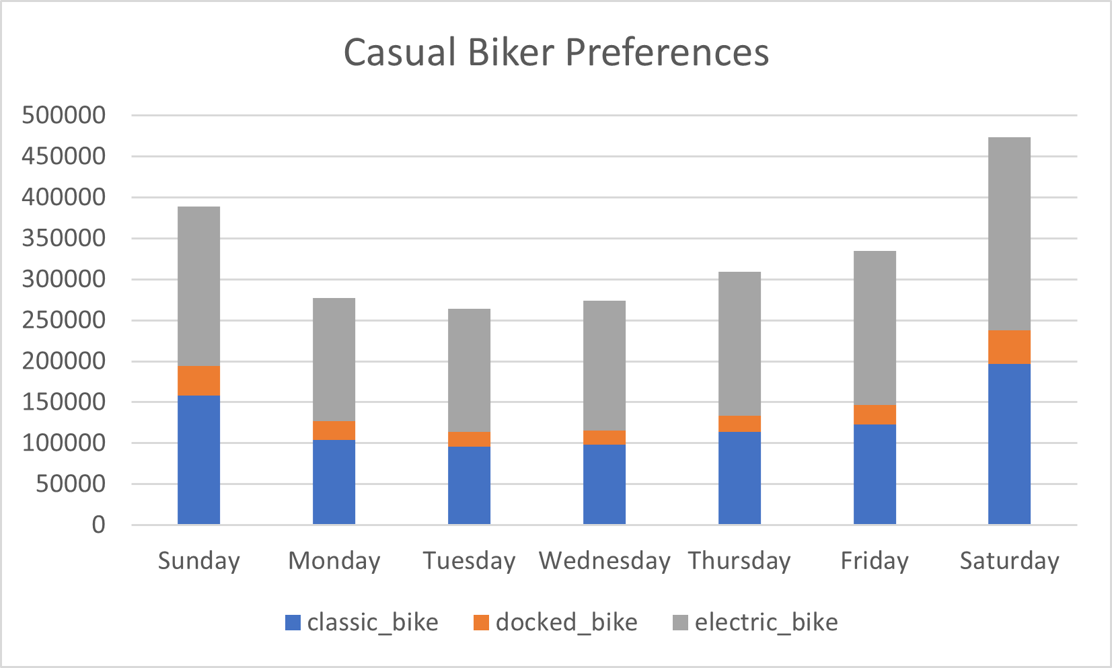
Casual Biker Preferences
Docked bikes in bike usage
Casual bike on weekends
Electronic bikes
Notes:
As driven home by the previous illustrations, casual bikes tend to bike on the weekends.
Interestingly, however, they tend to prefer electric bikes. This may be taken into account for advertising.

Slide 7
Conclusions
Longer Casual Rides
Docked Bikes
Weekend Casual Rides
Electronic Bike Preference
Notes:
There are four main conclusions from this data analysis.
First, casual bikers tend to take longer rides relative to their member counterparts.
Second, docked bikes take up a significant portion of the ride time for casual bikers. Although this is a problem for casual bikers themselves, it may be posed into an opportunity for conversion of casual bikers into members.
Third, casual riders like to bike on the weekends. This further supports the suspicion that casual riders like to ride bikes recreationally, rather than for practical purposes.
Finally, electronic bikes are a preference among casual bikers. Although electronic bikes are also favorable among members, they are particularly a favorite for casual bikers.

Slide 8
Taking Actions
Bike Notifications
Rewards
Social Media
Notes:
To ultize the findings of these conclusions, three courses of action may be done.
First, in terms of the docking bike problem, more noticeable alerts may be given to casual bikers whenever they dock their bike. Not only will this ensure that they properly log off of the bike, as to not be continuously charged for bikes they are not using, but it will also be used as an opportunity to recommend becoming a member.
Second, membership can have a rewards program. Although the membership program is already cheaper in the long run for many bikers, the deal can be sweetened to entice newcomers to join the service. The rewards would be based on a ride length measurement. The longer the trip is, the more rewards the member would receive. Not only is this an enticement for prospective members, but it would also encourage existing members to bike more, generating more revenue.
Finally, social media can be catered and specialized. Existing members do not need the same level as advertisements as prospective members, so social media can be used to address the wants of our existing casual members. The rewards program, such as the one mentioned above, can be used to entice bikers financially. But also, social media posts may be made, depicting ordinary bikers in the lifestyle of casual bikers (recreational) but also as members. In other words, we would allow our posts to relate to a typical casual biker to entice them into the rewards progra,/

